Slide 1

Leveraging ChatGpt for Natural Language Query to SPARQL on Virtuoso
--Using TheSession, Wikidata, MusicBrainz as example
Junjun Cao
Postdoctor of DDMAL
Email: junjun.cao@mail.mcgill.ca
Style norm:
Except for the heading title being “black,text1”, other black is “light color 25%”

Slide 2
Section 1 TheSession Webpage Queries vs. Using SPARQL on Virtuoso
Section 2 Queries Only Executable Using SPARQL on Virtuoso but not on TheSession Webpage
Section 3 Queries across TheSession and Wikidata
Section 4 Queries across TheSession, MusicBrainz and Wikidata
Notes:
from simple to complex
not feasible on the session webpage

Slide 3


TheSession Webpage Queries
vs. Using SPARQL on Virtuoso
The “session”: mostly informal gatherings at which people play Irish traditional music.
Note: For 1,2 of the comparison, before executing the generated SPARQL, please fill in “Default Data Set Name (Graph IRI)”option with <http://sample/thesession/reconciled> at the SPARQL Endpoint.
Notes:
What is TheSession database? It’s for traditional Irish music. are mostly informal gatherings at which people play Irish traditional music.

Slide 4
Q1-1: Find all the sessions that took place in Greece
Q1-2: Find the tunes of genre “jig,” in “D major,” having “Malcolm” in its name
Q1-3: Find albums containing “Tola” in its name or its artist’s name
Q1-4: Find albums related to “Mirella”
Q1-5: Find sessions that took place on Sundays and in Australia.

Slide 5
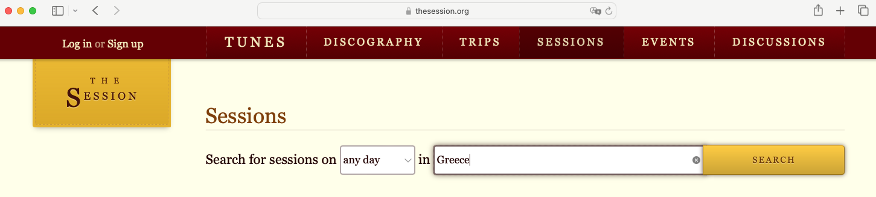
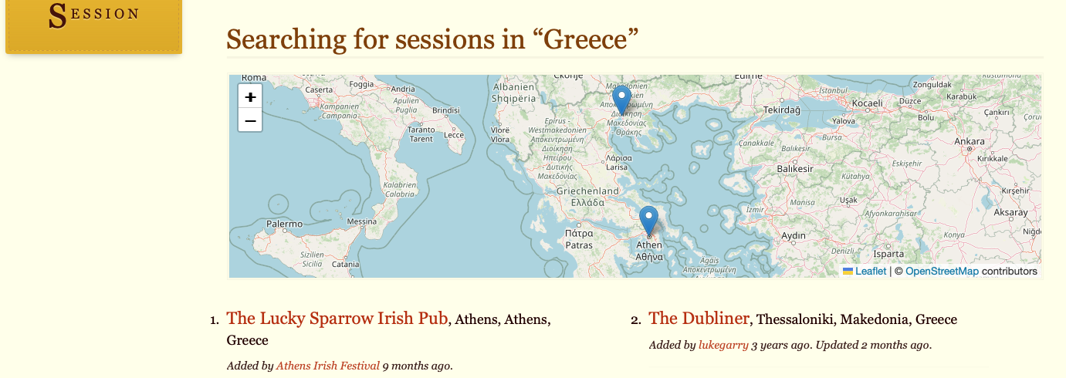
Searching on TheSession webpage (Q1-1)
https://thesession.org/sessions

Slide 6
Prompting ChatGPT to generate SPARQL query (Q1-1)
SPARQL: SPARQL Protocol and RDF Query Language
Enter the following in ChatGPT (the text in red will be provided to users):
Given a database reconciled with Wikidata, knowing `?session a <https://thesession.org/sessions>`, for question “Find the sessions that took place (wdt:P17) in Greece”, please generate a SPARQL query. Don’t forget namespace.
Notes:
SPARQL is akin to SQL for RDB

Slide 7
Generated SPARQL by ChatGPT (Q1-1) Find the sessions that took place in Greece
PREFIX wdt: <http://www.wikidata.org/prop/direct/>
PREFIX wd: <http://www.wikidata.org/entity/>
PREFIX rdf: <http://www.w3.org/1999/02/22-rdf-syntax-ns#>
SELECT DISTINCT ?session
WHERE {
?session rdf:type <https://thesession.org/sessions> .
?session wdt:P17 wd:Q41 . # P17 is the 'country' property, and Q41 is the Wikidata entity for Greece
}
wdt:P17, country
In order for you to generate the following SPARQL, how should I ask you in a natural language (English)?
ChatGpt 4o:
“Can you provide a SPARQL query to retrieve sessions from The Session website that are located in Greece, including the session’s name?”

Slide 8
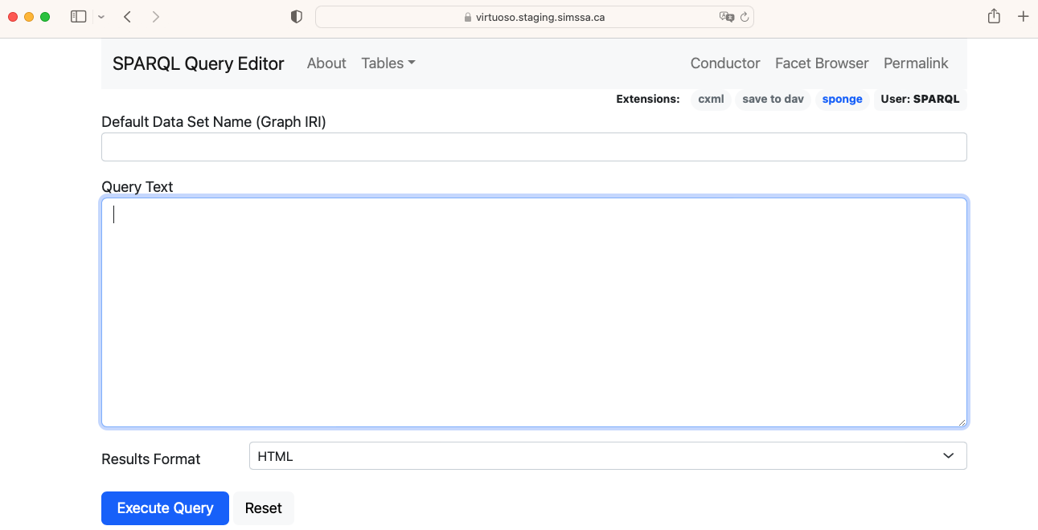
Virtuoso SPARQL query interface (Q1-1)

Slide 9
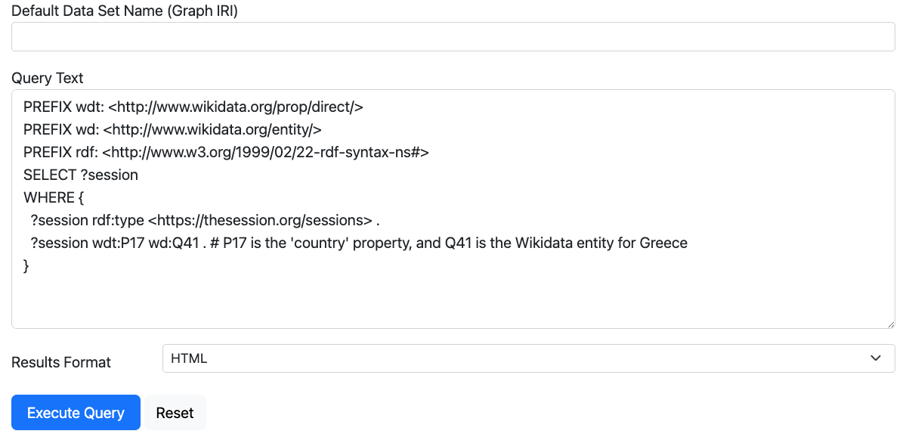
Copy SPARQL code then Execute (Q1-1)
https://virtuoso.staging.simssa.ca/sparql
http://sample/thesession/reconciled

Slide 10
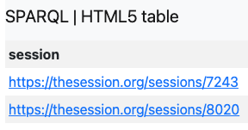
The result from Virtuoso (Q1-1)
This is why Linked Data is associated with “Semantic Network”?
Notes:
Why Linked Data is equivalent to Semantic Network?

Slide 11
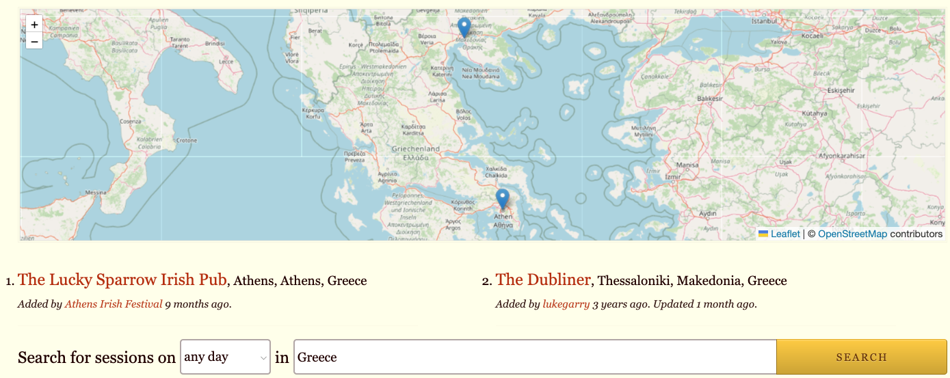
Comparison with The Session result (Q1-1)

Slide 12

Prompting ChatGPT to generate SPARQL query (Q1-1) Using Ontology (OWL, Web Ontology Language) as a schema
Though it’s not rigorous to define me this way
Enter the following in ChatGPT (the text in red will be provided to users):
Given that the properties of an RDF database are reconciled with Wikidata,
and ```
@prefix wd: <http://www.wikidata.org/entity/> .
@prefix wdt: <http://www.wikidata.org/prop/direct/> .
<https://thesession.org/sessions> rdf:type owl:Class .
wdt:P2561 rdfs:label "name"; rdfs:domain <https://thesession.org/sessions> .
wdt:P17 rdfs:domain <https://thesession.org/sessions>.
```
Make sure to generate a correct SPARQL for the following question:
Find all the sessions that took place in Greece
Notes:
Framework => ontology

Slide 13
Generated SPARQL by ChatGPT (Q1-1) Find all the sessions that took place in Greece
PREFIX wd: <http://www.wikidata.org/entity/>
PREFIX wdt: <http://www.wikidata.org/prop/direct/>
SELECT DISTINCT ?session ?name
WHERE {
?session rdf:type <https://thesession.org/sessions> ;
wdt:P17 wd:Q41 ; # Assuming wd:Q41 is the Wikidata entity for Greece
wdt:P2561 ?name .
}
wdt:P17, country
In order for you to generate the following SPARQL, how should I ask you in a natural language (English)?
ChatGpt 4o:
“Can you provide a SPARQL query to retrieve sessions from The Session website that are located in Greece, including the session’s name?”

Slide 14
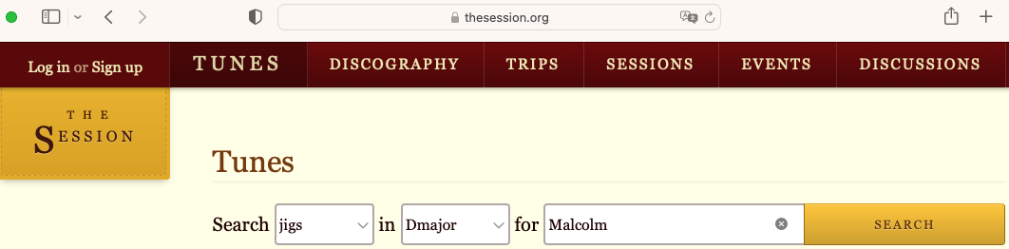
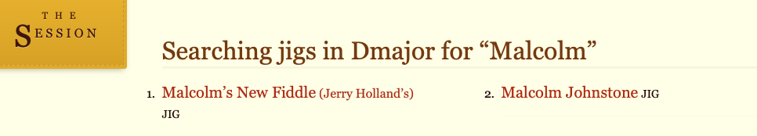
Searching on TheSession webpage (Q1-2)
https://thesession.org/tunes

Slide 15
Prompting ChatGPT to generate SPARQL query (Q1-2)
Enter the following in ChatGPT (the text in red will be provided to users):
Given an RDF database reconciled with Wikidata, and
```
wd:Q170412 rdf:type owl:Class ; rdfs:label "tune" .
wdt:P136 rdfs:type owl:DatatypeProperty ; rdfs:label "genre" .
wdt:P826 rdfs:type owl:DatatypeProperty ; rdfs:comment "This property is also used about the tonality of a tune etc" .
wdt:P2561 rdfs:label "name" .
```
Generate SPARQL for the following[Note: SPARQL be syntactically right such as `filter(contains(lcase(str(?x))`. For string values, please add @en ]:
Find the tunes of genre “jig”, in “D major”, having “Malcolm” in its name

Slide 16
Generated SPARQL by ChatGPT (Q1-2) Find the tunes of genre “jig”, in “D major”, having “Malcolm” in its name
PREFIX wd: <http://www.wikidata.org/entity/>
PREFIX wdt: <http://www.wikidata.org/prop/direct/>
PREFIX rdfs: <http://www.w3.org/2000/01/rdf-schema#>
PREFIX rdf: <http://www.w3.org/1999/02/22-rdf-syntax-ns#>
SELECT ?tune ?name
WHERE {
?tune rdf:type wd:Q170412 ;
wdt:P136 "jig"@en ;
wdt:P826 "D major"@en ;
wdt:P2561 ?name .
FILTER (CONTAINS(LCASE(STR(?name)), "malcolm")) }
In order for you to generate the following SPARQL, how should I ask you in a natural language (English)?
ChatGpt 4o:
“Can you retrieve all musical compositions that are of the type tune, specifically jigs, in the key of D major, and whose name contains the word ‘Malcolm’? Please provide the identifiers of these tunes and their names.”

Slide 17
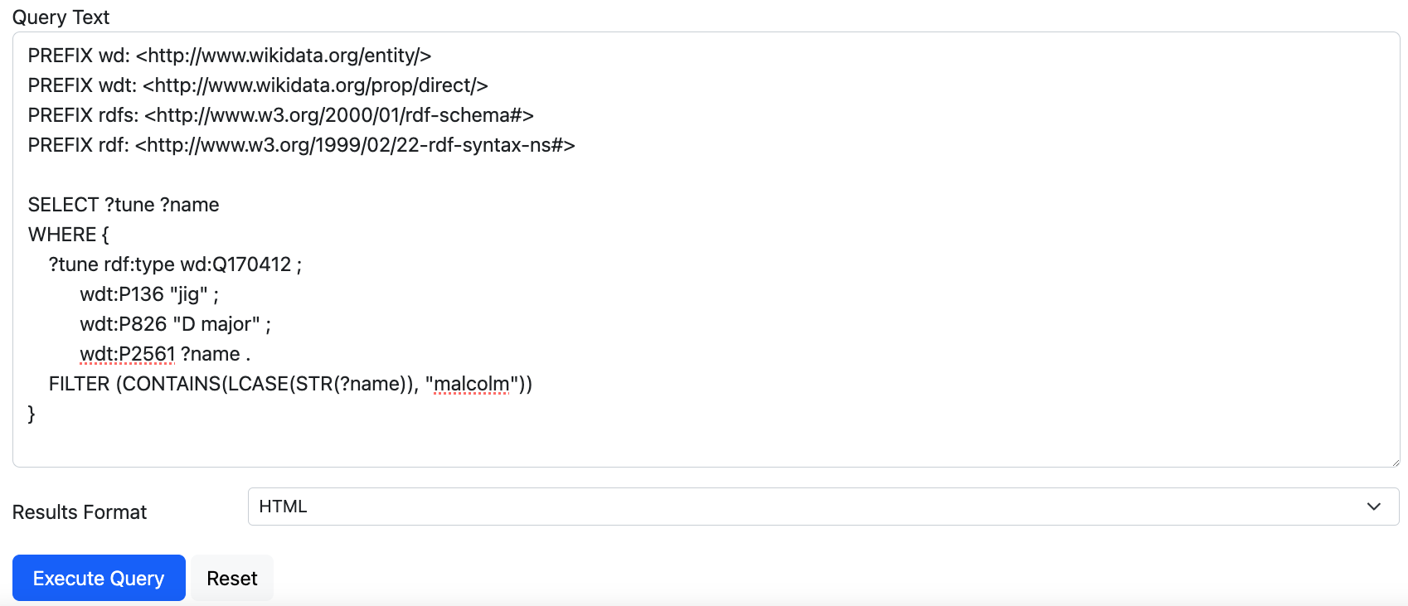
Copy SPARQL code then Execute (Q1-2)

Slide 18
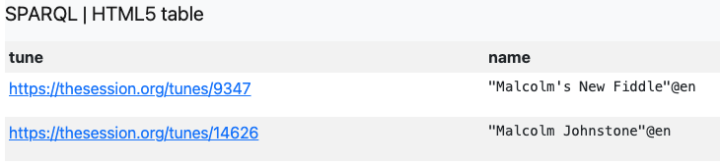
The result from Virtuoso (Q1-2)

Slide 19
Comparison with The Session result (Q1-2)
Notes:
web front end

Slide 20
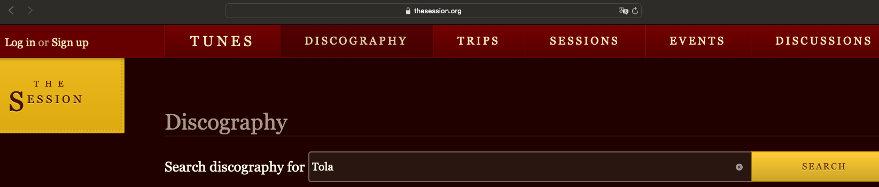
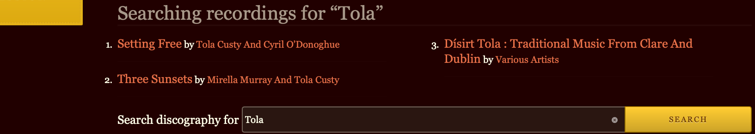
Searching on TheSession webpage (Q1-3)
We may consider insert a simpler question before this one.
Notes:
bound with the author

Slide 21
Prompting ChatGPT to generate SPARQL query (Q1-3)
Enter the following in ChatGPT (the text in red will be provided to users):
Given an RDF database partially reconciled with Wikidata, and:
wd:Q482994 a owl:Class . wdt:P175 a owl:DatatypeProperty .
wdt:P2561.
Generate SPARQL for the following question:
[Note: (1)The value of wdt:P175 is only rdf:literal instead of a URI, so it mustn’t be subject of other property.
(2)The subject of wdt:P2561 can only be instances of wd:Q482994.
(3)Use filter(contains(lcase(str(?x)). Any parts joined by UNION should be in {}.
(4)Don’t forget namespace]
Question: Find albums containing “Tola” in its name or its artist’s name
wd:Q482994 album;
wdt:P175 performer
Why this query is complicated:
(1) ChatGpt is prone to taking wdt:P175 as an “ObjectProperty”, which means it takes the object of P175 as another object (target/URI/node), such as:
SELECT ?album WHERE {
{
?album a wd:Q482994 ; # Identify the album (instance of wd:Q482994)
wdt:P2561 ?albumName . # Get the name of the album
FILTER(CONTAINS(LCASE(STR(?albumName)), "tola"))
}
UNION
{
?album a wd:Q482994 ; # Identify the album (instance of wd:Q482994)
wdt:P175 ?artist . # Get the artist of the album
?artist wdt:P2561 ?artistName . # Get the name of the artist
FILTER(CONTAINS(LCASE(STR(?artistName)), "tola"))
}
}
(2) It also uses wdt:P2561 as the property of ?artist, which is not hinted in the OWL snippet. So we stipulate “The subject of wdt:P2561 can only be instances of wd:Q482994”.
(For example, change to “Find the Album by Tola”)
Notes:
clue
the appropriate way to ask

Slide 22
Generated SPARQL by ChatGPT (Q1-3) Find albums containing “Tola” in its name or its artist’s name
PREFIX wd: <http://www.wikidata.org/entity/>
PREFIX wdt: <http://www.wikidata.org/prop/direct/>
PREFIX rdfs: <http://www.w3.org/2000/01/rdf-schema#>
PREFIX rdf: <http://www.w3.org/1999/02/22-rdf-syntax-ns#>
SELECT ?album ?name ?artistName WHERE { {
?album rdf:type wd:Q482994 ;
wdt:P2561 ?name . FILTER(contains(lcase(str(?name)), "tola"))
} UNION {
?album rdf:type wd:Q482994 ;
wdt:P175 ?artistName .
FILTER(contains(lcase(str(?artistName)), "tola"))}}
In order for you to generate the following SPARQL, how should I ask you in a natural language (English)?
ChatGpt 4o:
“Can you give me a list of albums where either the album’s name or the artist’s name includes the string ‘tola’? I need the album entity, its name, and the artist’s name.”

Slide 23
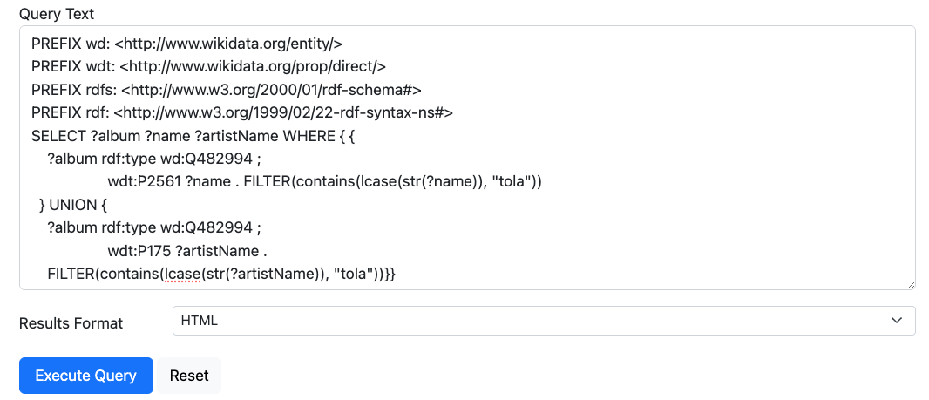
Copy SPARQL code then Execute (Q1-3)

Slide 24
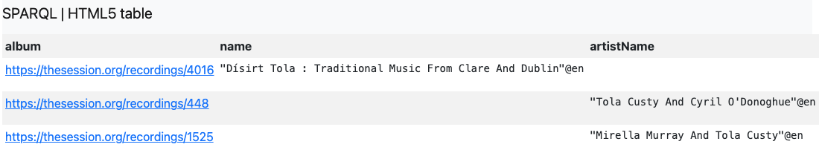
The result from Virtuoso (Q1-3)

Slide 25
Comparison with The Session result (Q1-3)

Slide 26
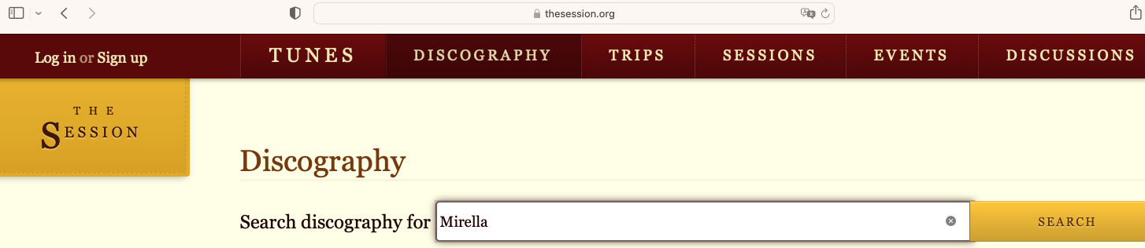
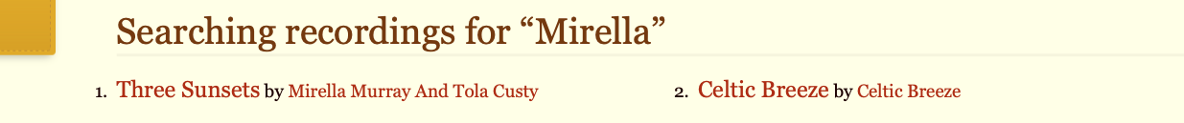
Searching on TheSession webpage (Q1-4)

Slide 27
Prompting ChatGPT to generate SPARQL query (Q1-4)
Enter the following in ChatGPT (the text in red will be provided to users):
Given an RDF database partially reconciled with Wikidata, and:
```
wd:Q482994 rdf:type owl:Class .
ex:Shape a sh:NodeShape ; sh:targetClass wd:Q482994 ; sh:not [ sh:property [ sh:path rdfs:label ]].
```
Generate SPARQL for the following question:
[Caution: Use filter(contains(lcase(str(?x)); “related to” means some of one’s attributes contains “Mirella”]
Find albums related to “Mirella”

Slide 28
Generated SPARQL by ChatGPT (Q1-4) Find albums related to “Mirella”
PREFIX wd: <http://www.wikidata.org/entity/>
PREFIX rdfs: <http://www.w3.org/2000/01/rdf-schema#>
PREFIX rdf: <http://www.w3.org/1999/02/22-rdf-syntax-ns#>
PREFIX wdt: <http://www.wikidata.org/prop/direct/>
SELECT DISTINCT ?album ?attribute ?value WHERE {
?album rdf:type wd:Q482994 .
?album ?attribute ?value .
FILTER (contains(lcase(str(?value)), "mirella")).
}
In order for you to generate the following SPARQL, how should I ask you in a natural language (English)?
ChatGpt 4o:
“How can I retrieve a list of albums and their attributes where the attribute value contains the word ‘mirella’, using SPARQL and considering the albums as entities of type wd:Q482994?”

Slide 29
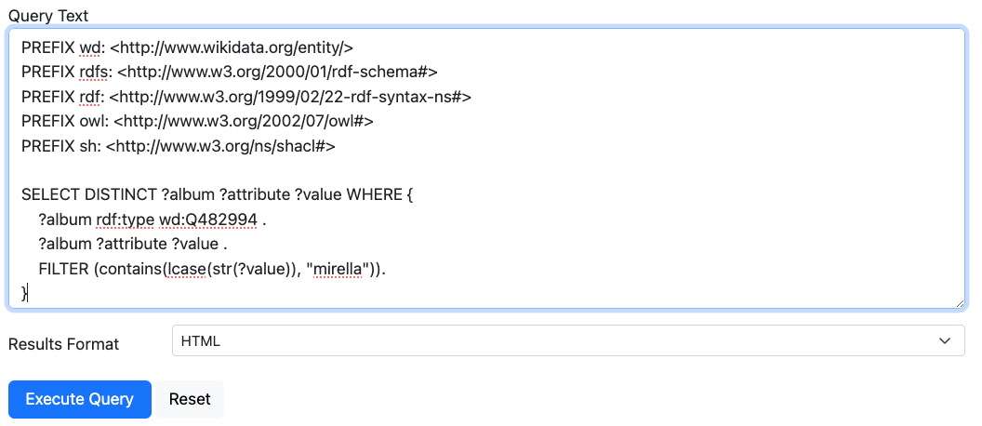
Copy SPARQL code then Execute (Q1-4)

Slide 30
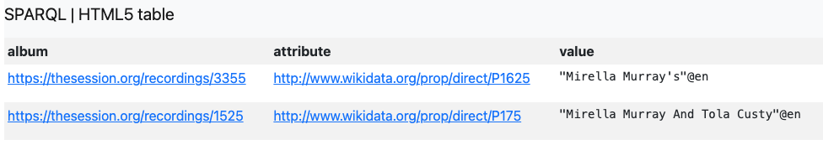
The result from Virtuoso (Q1-4)

Slide 31
Comparison with The Session result(Q1-4)
Notes:
wdt:P175 performer
wdt:P1625 has melody

Slide 32
A comprehensive context for several questions (from Q1-1 to Q1-4)
We can merge the different contexts into a single prompt for ChatGPT to generate SPARQL queries for various questions, such as those previously mentioned:
Q1-1: Find all the sessions that took place in Greece
Q1-2: Find the tunes of genre “jig,” in “D major,” having “Malcolm” in its name
Q1-3: Find albums containing “Tola” in its name or its artist’s name
Q1-4: Find albums related to “Mirella”
Find the Album containing “Mirella” in any of its attribute
Notes:
round up

Slide 33
The entire context for generating various SPARQL queries (Sec1)
Note:
1. In terms of SPARQL generation, it must be syntactically right such as:
(1) `filter(contains(lcase(str(?x))`--Don't forget str() function
(2) Any parts joined by `UNION` should be in {}
(3) All the namespace prefixes should be defined for each SPARQL query
2. SPARQL generation should strictly adhere to the given context associated with OWL or SHACL, etc.
For example, distinguish between ObjectProperty and DataProperty!
As above, pay attention: wdt:P136, wdt:P175 and wdt:P826 are DataProperties! So, for example, the value of wdt:P175 are only strings in our context!
3. “related to” means some of one’s attributes contains “Mirella”
Make sure to generate correct SPARQL for the following
4. For string values, please add @en
question:
Given that the entities of an RDF database are
reconciled with Wikidata, and
``` @prefix wd: <http://www.wikidata.org/entity/> .
@prefix wdt: <http://www.wikidata.org/prop/direct/> .
@prefix thesession: <https://thesession.org/> .
thesession:sessions rdf:type owl:Class . wdt:P17
wdt:P136 a owl:DatatypeProperty ; rdfs:label "genre" .
wdt:P175 a owl:DatatypeProperty .
wdt:P826 a owl:DatatypeProperty ; rdfs:label "mode" ;
rdfs:comment "also used for the tonality of a tune" .
wdt:P2561 rdfs:label "name" .
rdfs:domain thesession:sessions .
wd:Q170412 a owl:Class ;
rdfs:label "tune" .
wd:Q482994 a owl:Class .
ex:Shape a sh:NodeShape ; sh:targetClass wd:Q482994 ; sh:not [ sh:property [ sh:path rdfs:label, wdt:P1476 ]].
```
Notes:
The key point is, how should we prepare a context mainly consisting of ontology, in order to generate SPARQLs for various question?
It would be encouraged that we understand what the ontology is. We will talk about it as well as the basic principle of SPARQL before long

Slide 34
2. Queries only Executable Using SPARQL on Virtuoso but not on TheSession Webpage
Notes:
restraint or restrained

Slide 35
Q2-1: Find a session named "Hurley’s Irish Pub"
Q2-2: What genres appear in the recording whose artist is "Adam Agee & Jon Sousa"?
Q2-3: Find the session that took place within a 20-kilometer radius centered on the session "Hurley’s Irish Pub"
Q2-4: 找到在希腊的演奏会 (mandarin / Chinese, translated as “Find sessions in Greece”)
Q2-5 How many musicians (performers) are on TheSession (or on WikiData / MusicBrainz) (Investigate how many performers are to be reconciled: How many musicians are not on Wikidata?
Those which are not reconciled successfully are naturally not on Wikidata

Slide 36
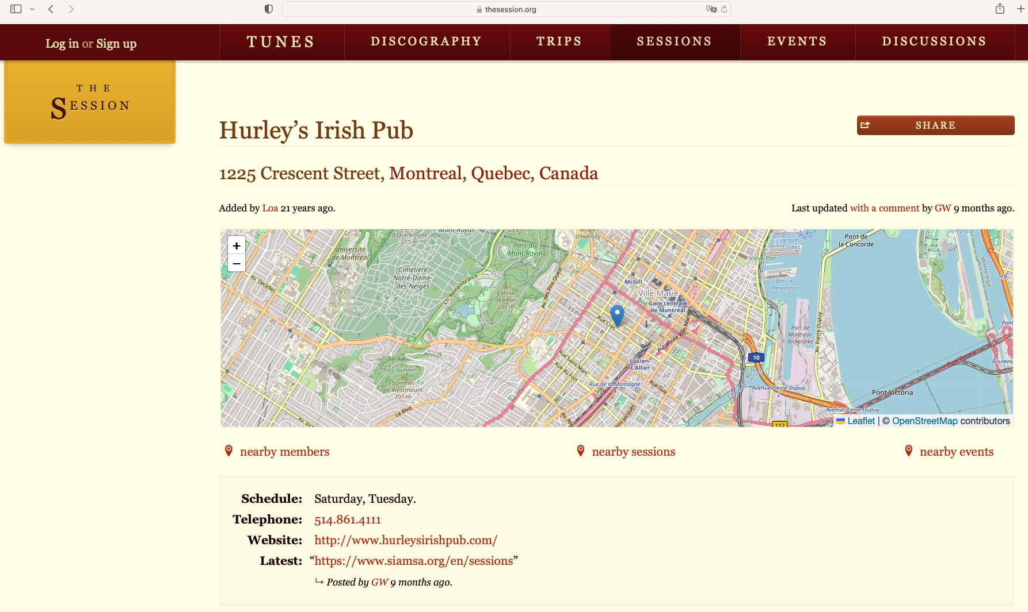
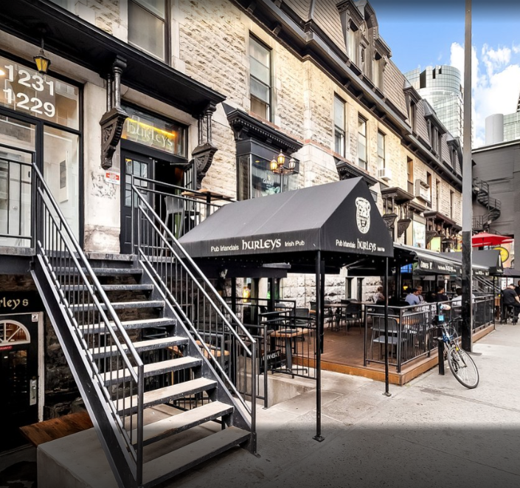
Hurley’s Irish Pub

Slide 37
Prompting ChatGPT to generate SPARQL query (Q2-1)
Enter the following in ChatGPT (the text in red will be provided to users):
Given an RDF database with properties(wdt:P2561) reconciled with Wikidata, generate SPARQL for the following (Use wdt:P2561 instead of rdfs:label. For string values, please add @en):
Find a session named "Hurley’s Irish Pub"

Slide 38
Generated SPARQL by ChatGPT (Q2-1) Find a session named "Hurley’s Irish Pub"
PREFIX wdt: <http://www.wikidata.org/prop/direct/>
SELECT ?session
WHERE {
?session wdt:P2561 "Hurley's Irish Pub"@en .
}
Subject predicate object
(property) (property value)
In order for you to generate the following SPARQL, how should I ask you in a natural language (English)?
ChatGpt 4o:
“Can you create a SPARQL query that selects sessions which are specifically linked to ‘Hurley’s Irish Pub’, and ensure these sessions are identified as types within the ‘https://thesession.org/sessions’ namespace?”

Slide 39
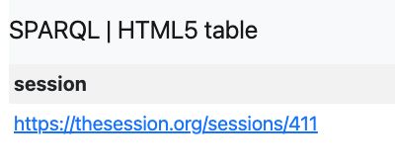
The result from Virtuoso (Q2-1)
https://thesession.org/sessions/411

Slide 40
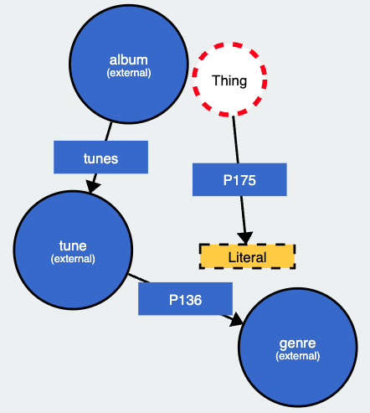
Prompting ChatGPT to generate SPARQL query (Q2-2)
Enter the following in ChatGPT (the text in red will be provided to users):
Given an RDF database reconciled with Wikidata(such as Q482994)
and ```
@PREFIX thesession: <https://thesession.org/> .
wd:Q170412 rdfs:label “tune” .
wd:Q482994 rdfs:label “album” .
wd:Q483394 rdfs:label “genre” .
wdt:P175 rdf:type owl:DatatypeProperty . #even if it’s an
ObjectProperty in Wikidata, here we take is as DataProperty
thesession:tunes rdfs:domain wd:Q482994 ;
rdfs:range wd:Q170412 .
wdt:P136 rdfs:domain wd:Q170412 ;
rdfs:range wd:Q483394 . ```
Generate SPARQL for the following[note: No need to return
the label of an entity. For string property values, please add @en]:
What genres appear in the album whose artist is "Adam Agee & Jon Sousa"?
wd:Q482994
wd:Q170412
thesession:tunes
wd:Q483394
wdt:P175 performer
wdt:P136 genre
It’s involved with some reasoning based on the structure of the ontology: Find the genre related to the tune related to the album.
It may raise a discussion, see:
https://github.com/DDMAL/linkedmusic-queries/discussions/18
If it can not generate the desired SPARQL, hint again with `wdt:P175 rdf:type owl:DatatypeProperty .`
Notes:
This denotes apparently...
I want to illustrate
graph structure in which the nodes represent classes and the edges represent properties
reasoning based on path in the graph, or on graph structure
formulate

Slide 41
Generated SPARQL by ChatGPT (Q2-2) What genres appear in the album whose artist is "Adam Agee & Jon Sousa"?
PREFIX thesession: <https://thesession.org/>
PREFIX wd: <http://www.wikidata.org/entity/>
PREFIX wdt: <http://www.wikidata.org/prop/direct/>
SELECT DISTINCT ?genre
WHERE {
# Match the album of the artist "Adam Agee & Jon Sousa"
?album wdt:P175 "Adam Agee & Jon Sousa"@en .
# Find all tunes in the matched albums
?album thesession:tunes ?tune .
# Find genres of the matched tunes
?tune wdt:P136 ?genre . }
In order for you to generate the following SPARQL, how should I ask you in a natural language (English)?
ChatGpt 4o:
“”

Slide 42
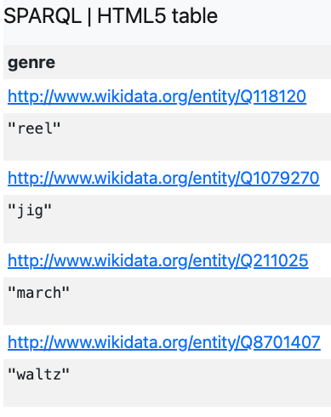
The result from Virtuoso (Q2-2)

Slide 43
Prompting ChatGPT to generate SPARQL query (Q2-3)
Enter the following in ChatGPT (the text in red will be provided to users):
Given an RDF database reconciled with Wikidata and
```
wdt:P625 rdfs:domain <https://thesession.org/sessions> .
wdt:P2561 rdfs:label “sessionName” ; rdfs:domain <https://thesession.org/sessions> .
```
Use bif:st_distance(). Remember to confine the type for entities .
Generate SPARQL for the following (For string property values, please add @en):
Find other sessions that took place within a 20-kilometer radius centered on the session "Hurley's Irish Pub"
This prompt is not robust enough.
chatGpt knows what wdt:P625 is; the context provided above is not robust enough

Slide 44
Generated SPARQL by ChatGPT (Q2-3) Find other sessions that took place within a 20-kilometer radius centered on the session "Hurley's Irish Pub"
PREFIX wdt: <http://www.wikidata.org/prop/direct/>
PREFIX rdfs: <http://www.w3.org/2000/01/rdf-schema#>
SELECT ?session ?sessionName ?location ?distance
WHERE {
# Find the location of "Hurley's Irish Pub"
?centerSession wdt:P2561 "Hurley's Irish Pub"@en ;
wdt:P625 ?centerLocation .
# Find other sessions and their locations
?session a <https://thesession.org/sessions> ;
wdt:P2561 ?sessionName ;
wdt:P625 ?location .
# Calculate distance between "Hurley's Irish Pub" and other sessions
BIND(bif:st_distance(?centerLocation, ?location) AS ?distance)
# Filter sessions within a 20-kilometer radius
FILTER(?distance <= 20)} ORDER BY ?distance

Slide 45
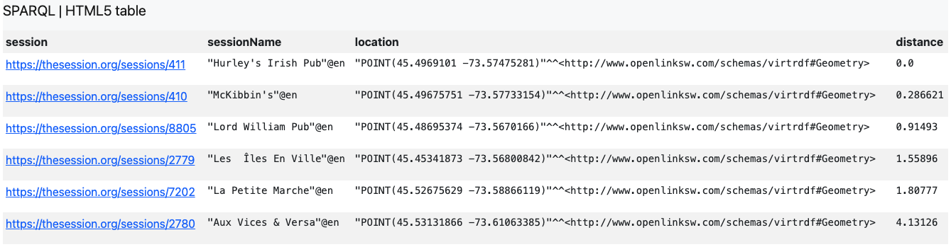
The result from Virtuoso (Q2-3)
geographical coordinates

Slide 46
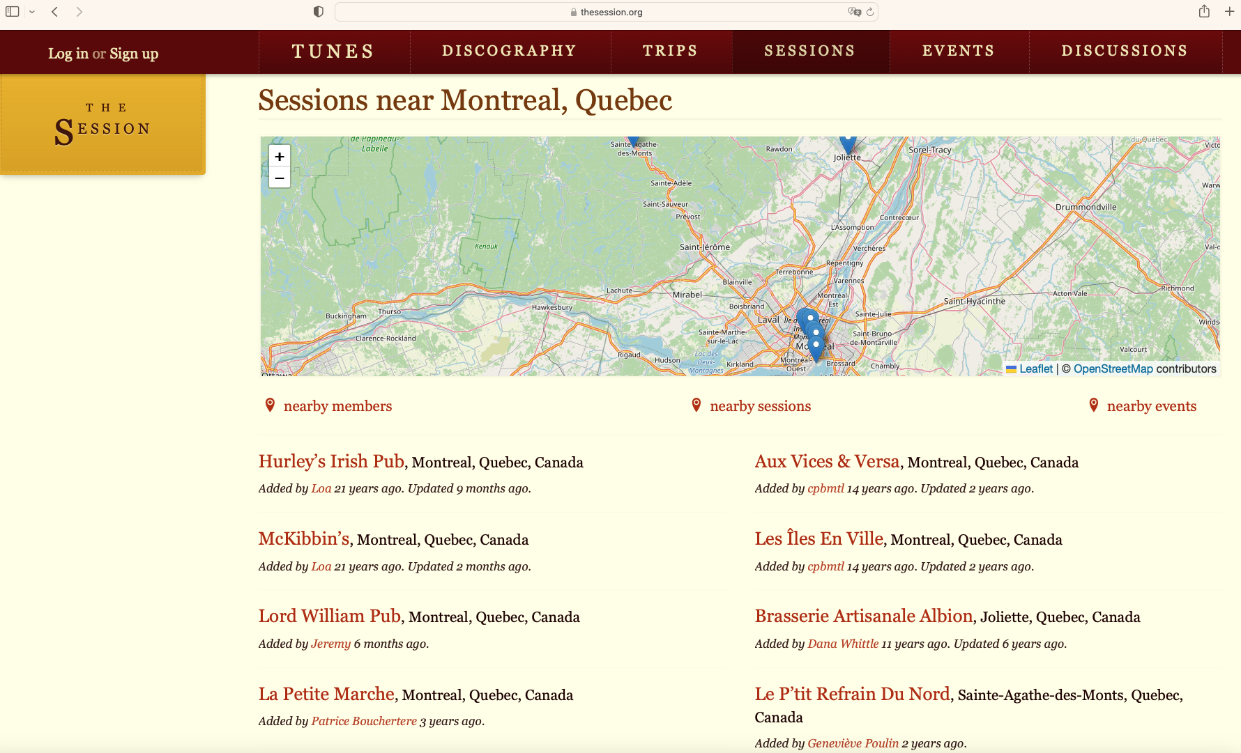
A similiar result from TheSession
https://thesession.org/sessions/411
Notes:
We don't know what bench mark of distance is set to define the so called "nearby"

Slide 47
Prompting ChatGPT to generate SPARQL query (Q2-4)
Enter the following in ChatGPT (the text in red will be provided to users):
Given an RDF database reconciled with Wikidata, and
```
@prefix wd: <http://www.wikidata.org/entity/> .
@prefix wdt: <http://www.wikidata.org/prop/direct/> .
<https://thesession.org/sessions> a owl:Class .
wdt:P2561 rdfs:label "name";
rdfs:domain <https://thesession.org/sessions> .
wdt:P17 rdfs:domain <https://thesession.org/sessions>.
``` (use wdt:P2561 instead of rdfs:label)
Make sure to generate a correct SPARQL for the following question:
找到在希腊的演奏会 (mandarin / Chinese, translated as “Find sessions in Greece”)

Slide 48
Generated SPARQL by ChatGPT (Q2-4) 找到在希腊的演奏会 (mandarin / Chinese, translated as “Find sessions in Greece”)
PREFIX wd: <http://www.wikidata.org/entity/>
PREFIX wdt: <http://www.wikidata.org/prop/direct/>
PREFIX rdfs: <http://www.w3.org/2000/01/rdf-schema#>
SELECT ?session ?name
WHERE {
?session a <https://thesession.org/sessions> ;
wdt:P17 wd:Q41 ; # Q41 is the Wikidata entity ID for Greece
wdt:P2561 ?name .
}

Slide 49
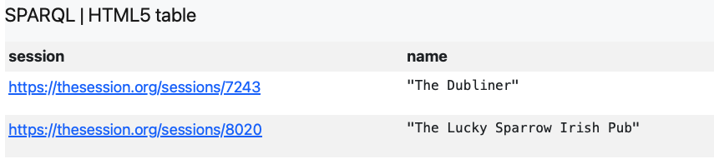
Comparison with The Session result (Q2-4)

Slide 50
A comprehensive context for several questions (from Q2-1 to Q2-4)
We can merge the different contexts into a single prompt for ChatGPT to generate SPARQL queries for various questions, such as those previously mentioned:
Q2-1: Find a session named "Hurley’s Irish Pub"
Q2-2: What genres appear in the recording whose artist is "Adam Agee & Jon Sousa"?
Q2-3: Find the session that took place within a 20-kilometer radius centered on the session "Hurley’s Irish Pub"
Q2-4: 找到在希腊的演奏会 (mandarin / Chinese, translated as Find sessions in Greece)

Slide 51
The entire context for generating various SPARQL queries (Sec2)
Given an RDF database with properties reconciled with Wikidata, and
@PREFIX thesession: <https://thesession.org/> .
@PREFIX wd: <http://www.wikidata.org/entity/> .
@PREFIX wdt: <http://www.wikidata.org/prop/direct/> .
thesession:sessions a owl:Class .
thesession:tunes rdfs:domain wd:Q482994 ;
rdfs:range wd:Q170412 ;
rdfs:comment "For albums have tunes" .
wd:Q170412 rdfs:label “tune” .
wd:Q482994 rdfs:label “album” .
wd:Q483394 rdfs:label “genre” .
wdt:P17 rdfs:domain thesession:sessions .
wdt:P175 rdf:type owl:DatatypeProperty .
wdt:P136 rdfs:domain wd:Q170412 ;
rdfs:range wd:Q483394 .
wdt:P625 rdfs:domain thesession:sessions .
wdt:P2561 rdfs:label “sessionName” ; rdfs:domain thesession:sessions .
Before generating SPARQL, note: 1. No need to return the label of an entity
2. Use bif:st_distance(), the unit in which is kilometer and bif: is not a namespace prefix
3. Remember to confine the type for entities
4. Don't forget the namespace prefix for each SPARQL query!!
5. Don't use property that's not provided above
6 .Albums don't relate genres directly, but Albums have tunes which relate genres
7. Even if wdt:P175 is an ObjectProperty in Wikidata, here we take is as DataProperty
8. For string property values, please add @en
Generate correct SPARQL for the following question:

Slide 52

3. Queries across TheSession and Wikidata
Some information is not available solely through TheSession. Given that we have already done reconciliation with Wikidata, we can extend our query to external data sources (e.g., Wikidata) for more specific questions such as...
Notes:
we can refer to the knowledge network from Wikidata more than just only the reconciled data

Slide 53
Q3-1: Which sessions took place in Eastern Europe?
Q3-2: From TheSession, please find recordings by Altan, which were known to be released between 2007 and 2012
Q3-3: Find in TheSession performers who are Canadians. And find the recordings they performed in TheSession
The information about the green part comes from Wikidata.
Q3-2: Query for a specific time period. Q3-3: Compound question
留意ChatGPT对同义词（synonyms）的敏感度. eg:published released

Slide 54
Prompting ChatGPT to generate SPARQL query (Q3-1)
Enter the following in ChatGPT (the text in red will be provided to users):
Given an RDF graph <http://sample/thesession/reconciled>, the properties and classes of instances are reconciled with Wikidata as much as possible, so regarding SPARQL queries across different databases, we use `graph <...>` and `service <...>`. and Given:
@prefix thesession: <https://thesession.org/>. thesession:sessions a owl:Class.
wdt:P17 rdfs:domain <https://thesession.org/sessions>.
wdt:P2561 rdfs:domain <https://thesession.org/sessions>.
--for graph <http://sample/thesession/reconciled>
wdt:P361 rdfs:domain <ex:country>. wd:Q27468 rdfs:label “Eastern Europe”.
--for service <https://query.wikidata.org/sparql>
Make sure to generate a correct SPARQL for the following question (Note: Use the properties or classes as above primarily; traverse wikidata before local graph):
Which sessions took place in Eastern Europe?
wdt:P361 part of
Explain why we need such adjustment:
Now we are querying across different databases [we call it “federal query”, please refer to https://github.com/DDMAL/linkedmusic-datalake/wiki/How-to-Query-across-different-Databases(Different-RDF-Data-Source)].
We have to give respective context from different data sources such as graph <http://sample/thesession/reconciled> and service <https://query.wikidata.org/sparql>

Slide 55
Generated SPARQL by ChatGPT (Q3-1) Which sessions took place in Eastern Europe?
PREFIX thesession: <https://thesession.org/>
PREFIX wdt: <http://www.wikidata.org/prop/direct/>
PREFIX wd: <http://www.wikidata.org/entity/>
PREFIX rdfs: <http://www.w3.org/2000/01/rdf-schema#>
SELECT ?session ?location WHERE {
SERVICE <https://query.wikidata.org/sparql> {
?location wdt:P361 wd:Q27468 . # Q27468 is the Wikidata item for Eastern Europe
}
GRAPH <http://sample/thesession/reconciled> {
?session wdt:P17 ?location .
?session a thesession:sessions . }}
wdt:P361, part of
wdt:P17,
country
Timeout when running the code on my localhost! But it’s result-generating on stagingVirtuoso
Notes:
invoke

Slide 56
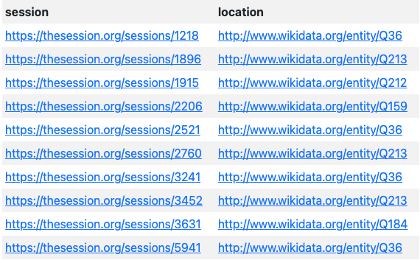
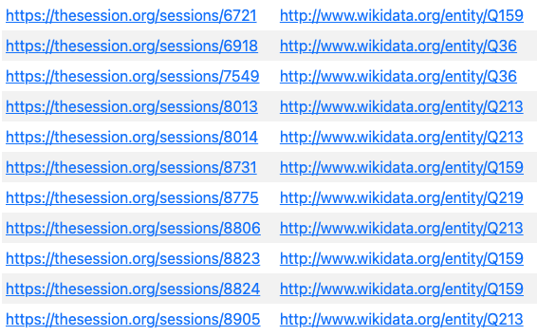
The result from Virtuoso (Q3-1)
Q36: Poland, Q159: Russia, Q184: Belarus, Q213: Czech Republic, Q219: Bulgaria

Slide 57
Prompting ChatGPT to generate SPARQL query (Q3-2)
Enter the following in ChatGPT (the text in red will be provided to users):
Given an RDF graph <http://sample/thesession/reconciled>, the properties and classes of instances are reconciled with Wikidata as much as possible, so regarding SPARQL queries across different databases, we use `graph <...>` and `service <...>`. and Given:
For graph <http://sample/thesession/reconciled> :
wd:Q482994 a owl:Class. wdt:P175 rdfs:domain wd:Q482994; a owl:DataProperty.
For service <https://query.wikidata.org/sparql> :
wdt:P577 rdfs:range xsd:dateTime.
Make sure to generate a correct SPARQL for the following question
(Note: Use the properties or classes as above primarily; Even if on Wikidata, wdt:P175 is an ObjectProperty, we see it as a DataProperty here; Use such as `?sessionRecording wdt:P2888 ?wikidataRecording .`; For string property values, please add @en):
From TheSession, please find recordings by Altan, which were known to be released between 2007 and 2012

Slide 58
Generated SPARQL by ChatGPT (Q3-2) From TheSession, please find recordings by Altan, which were known to be released between 2007 and 2012
PREFIX wdt: <http://www.wikidata.org/prop/direct/>
PREFIX wd: <http://www.wikidata.org/entity/>
PREFIX rdfs: <http://www.w3.org/2000/01/rdf-schema#>
PREFIX owl: <http://www.w3.org/2002/07/owl#>
PREFIX xsd: <http://www.w3.org/2001/XMLSchema#>
SELECT ?sessionRecording ?wikidataRecording ?releaseDate WHERE {
GRAPH <http://sample/thesession/reconciled> { ?sessionRecording a wd:Q482994 ;
wdt:P175 "Altan"@en .
?sessionRecording wdt:P2888 ?wikidataRecording .}
SERVICE <https://query.wikidata.org/sparql> { ?wikidataRecording wdt:P577 ?releaseDate .
FILTER (?releaseDate >= "2007-01-01T00:00:00Z"^^xsd:dateTime && ?releaseDate <= "2012-12-31T23:59:59Z"^^xsd:dateTime) }}
It takes a bit longer for retrieval
Notes:
a certain time span

Slide 59
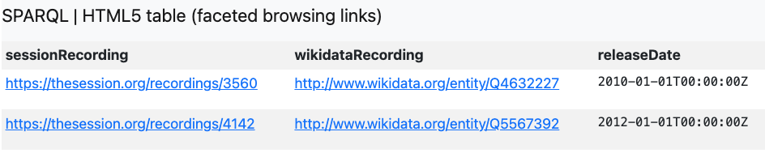
The result from Virtuoso (Q3-2)

Slide 60
Prompting ChatGPT to generate SPARQL query (Q3-3-0)
Enter the following in ChatGPT (the text in red will be provided to users):
Given an RDF graph <http://sample/thesession/reconciled>, the properties and classes of instances are reconciled with Wikidata as much as possible, so regarding SPARQL queries across different databases, we use `graph <...>` and `service <...>`. and Given:
The value of wdt:P175 is performer
--for graph <http://sample/thesession/reconciled>
wdt:P27
--for service <https://query.wikidata.org/sparql>
Make sure to generate a correct SPARQL for the following question:
Find in TheSession performers who are Canadians ...
wdt:P175 performer
wdt:P27 country of citizenship
The information about nationality of performering artists is only available on Wikidata
(Note: Use the properties or classes as above primarily):
Notes:
divide the procedure more detailedly

Slide 61
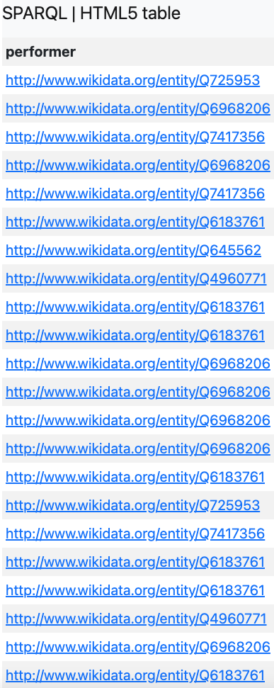
Expected SPARQL (Q3-3-0) Find in TheSession performers who are Canadians
PREFIX wdt: <http://www.wikidata.org/prop/direct/>
PREFIX wd: <http://www.wikidata.org/entity/>
SELECT ?performer
WHERE {
GRAPH <http://sample/thesession/reconciled> {
?x a wd:Q482994 ;
wdt:P175 ?performer .
FILTER isIRI(?performer)
}
SERVICE <https://query.wikidata.org/sparql> {
?performer wdt:P27 wd:Q16
}}
It returns results slowly on my localhost, but sometimes caused timeout on staging Virtuoso

Slide 62
Prompting ChatGPT to generate SPARQL query (Q3-3)
Enter the following in ChatGPT (the text in red will be provided to users):
Given an RDF graph <http://sample/thesession/reconciled>, the properties and classes of instances are reconciled with Wikidata as much as possible, so regarding SPARQL queries across different databases, we use
(1) `graph <http://sample/thesession/reconciled>` with:
wd:Q482994 rdfs:label “recording”. wdt:P175 # the value of it can be either rdfs:Literal or URI
(2) `service <https://query.wikidata.org/sparql>` with:
wdt:P27
[Note: Use isIRI(?performer); Don’t use `rdfs:label` as a predicate in SPARQL anyway!]
Make sure to generate a correct SPARQL for the following question:
Find in TheSession performers who are Canadians. And find the recordings they performed in TheSession

Slide 63

Generated SPARQL by ChatGPT (Q3-3) Find in TheSession performers who are Canadians. And find the recordings they performed in TheSession
PREFIX rdfs: <http://www.w3.org/2000/01/rdf-schema#>
PREFIX wd: <http://www.wikidata.org/entity/>
PREFIX wdt: <http://www.wikidata.org/prop/direct/>
SELECT ?performer ?recording WHERE {
GRAPH <http://sample/thesession/reconciled> {
?recording wdt:P175 ?performer .
}
SERVICE <https://query.wikidata.org/sparql> {
?performer wdt:P27 wd:Q16 .
}
FILTER(isIRI(?performer)) }
Note: It probably takes a long time to get the result from running the code on localhost; sometimes, it reports timeout.
Recently, there is timeout on staging

Slide 64
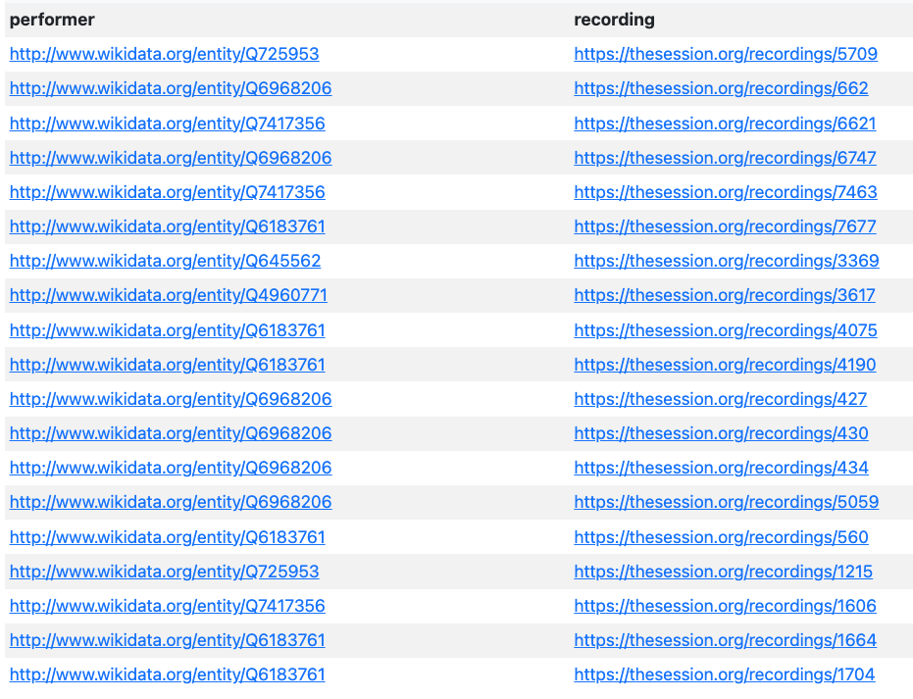
The result from Virtuoso (Q3-3)

Slide 65

4. Queries across TheSession, MusicBrainz and Wikidata

Slide 66
Q4-1: How many / Which recording performers on TheSession (who) are not on MusicBrainz?
Q4-2: List top five most popular record labels used by musicians on TheSession?
Q2-3: List all albums recorded by bands in TheSession, that was released in 2003 in America
Q3-2: Query with counting items (statistics). Q3-3: Query across 3 databases

Slide 67
Prompting ChatGPT to generate SPARQL query (Q4-1-1)
Enter the following in ChatGPT (the text in red will be provided to users):
Given RDF graphs <http://sample/thesession/reconciled> and <http://musicbrainz/reconciled>, the properties and classes of instances are reconciled with Wikidata as much as possible,
so regarding SPARQL queries across different databases, we use
(1) `graph <http://sample/thesession/reconciled>` with:
wdt:P175 rdfs:range ex:performer.
(2) `graph <http://musicbrainz/reconciled>` with:
wdt:P2888 rdfs:range ex:performer.
[note: DISTINCT; The value of performer must be IRI, that should be embodied earlier in SPARQL, please use FILTER isIRI()]
Make sure to generate a correct SPARQL for the following question:
How many recording performers on TheSession are not on MusicBrainz?

Slide 68
Generated SPARQL by ChatGPT (Q4-1-1) How many recording performers on TheSession are not on MusicBrainz?
PREFIX wdt: <http://www.wikidata.org/prop/direct/>
SELECT (COUNT(DISTINCT ?performer)
AS ?performerCount) WHERE {
GRAPH <http://sample/thesession/reconciled>
{?recording wdt:P175 ?performer .
FILTER isIRI(?performer)
}
FILTER NOT EXISTS {
GRAPH <http://musicbrainz/reconciled> {
?otherRecording wdt:P2888 ?performer .
FILTER isIRI(?performer)
}}}
Comments:This Q4-1 actually gives us an inspiration: If we haven’t asserted the type of some entity such as performer. It would be diffcult to express the context and SPARQL to get the desired result: in this case, we have to use wdt:P175 to confine ?performer. In the former context, we use a assumed “ex:performer”.
It is precisely because of this that I further believe embedding the types for as many entities as possible during the process of reconciliation is valuable; moreover, ontology is indeed valuable for SPARQL retrieval and plays a crucial role in data interoperability.

Slide 69
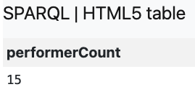
The result from Virtuoso (Q4-1-1)
Note: Why is the result such a small number? This is because only a small fraction of artists/performers from TheSession have been reconciled with Wikidata
For example, entities such as Q468576, Q434372, exist both in TheSession and MusicBrainz
Note: Why is the result such a small number? This is because only a small fraction of artists/performers from TheSession have been reconciled with Wikidata. To get an accurate answer, we can only compare the reconciled URIs with those reconciled in MusicBrainz. It is not recommended to reconcile solely based on the names of artists/performers, as this may lead to inaccuracies.

Slide 70
Prompting ChatGPT to generate SPARQL query (Q4-1-2)
Enter the following in ChatGPT (the text in red will be provided to users):
Given RDF graphs <http://sample/thesession/reconciled> and <http://musicbrainz/reconciled>, the properties and classes of instances are reconciled with Wikidata as much as possible,
so regarding SPARQL queries across different databases, we use
(1) `graph <http://sample/thesession/reconciled>` with:
wdt:P175 rdfs:range ex:performer.
(2) `graph <http://musicbrainz/reconciled>` with:
wdt:P2888 rdfs:range ex:performer.
[note: DISTINCT; The value of ex:performer must be IRI, that should be embodied in SPARQL]
Make sure to generate a correct SPARQL for the following question:
Which recording performers on TheSession are not on MusicBrainz?

Slide 71
Generated SPARQL by ChatGPT (Q4-1-2) Which recording performers on TheSession are not on MusicBrainz?
PREFIX wdt: <http://www.wikidata.org/prop/direct/>
SELECT DISTINCT ?performer
WHERE {
GRAPH <http://sample/thesession/reconciled> {
?recording wdt:P175 ?performer .
}
MINUS {
GRAPH <http://musicbrainz/reconciled> {
?otherRecording wdt:P2888 ?performer .
}}
FILTER(isIRI(?performer)) }

Slide 72
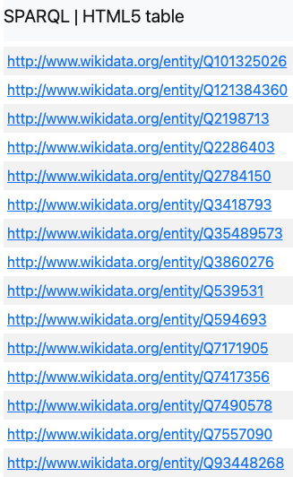
The result from Virtuoso (Q4-1-2)
...
For example, entities such as Q468576, Q434372, exist both in TheSession and MusicBrainz

Slide 73
Prompting ChatGPT to generate SPARQL query (Q4-2)
Enter the following in ChatGPT (the text in red will be provided to users):
Given RDF graphs <http://sample/thesession/reconciled> and <http://musicbrainz/reconciled>, the properties and classes of instances are reconciled with Wikidata as much as possible.
1. For graph <http://sample/thesession/reconciled/noLangLabel>:
wd:Q482994 a owl:Class; rdfs:label “Record”. wdt:P2561 rdfs:label “name”.
2. For graph <http://musicbrainz/reconciled>
wd:Q3972943 a owl:Class; rdfs:label “Record”.
wdt:P1476 rdfs:label “title”; rdfs:domain wd:Q3972943.
wdt:P264 rdfs:label “record label”; rdfs:domain wd:Q3972943; rdfs:range wd:Q18127.
wdt:P2561 rdfs:domain wd:Q18127; rdfs:comment “It’s the name of ‘record label’. Don't use rdfs:label as a predicate in the triple pattern of the generated SPARQL!”!!!
wd:Q18127 rdfs:label “Label”.
Make sure to generate an absolutely correct SPARQL for the following question
(Note: Primarily use the properties or classes mentioned above for each graph. You can use wdt:P2561 of wd:Q482994 to match wdt:P1476 of wd:Q3972943. Return both the URI of the record labels and the name of record labels):
List the top five most popular labels from MusicBrainz whose records are also on TheSession database
Given wd:Q482994 owl:equivalentClass wd:Q3972943.
List top five most popular record labels used by musicians on TheSession? ->deceptive, Modification:
used by musicians
the relationship between recording and recording label in
Notes:
a particularly deceptive question
Sometimes, ChatGPT makes mistakes by using like `?label rdfs:label ?labelName`, even if you have stipulated “Don‘t use rdfs:label as a predicate in the triple pattern of the generated SPARQL!”. If it generates the wrong result, you may remind it by drumming such stipulation.

Slide 74
Generated SPARQL by ChatGPT (Q4-2)
List the top five most popular labels from MusicBrainz whose records are also on TheSession database.
List top five most popular record labels used by musicians on TheSession?
PREFIX wd: <http://www.wikidata.org/entity/>
PREFIX wdt: <http://www.wikidata.org/prop/direct/>
PREFIX rdfs: <http://www.w3.org/2000/01/rdf-schema#>
SELECT ?labelURI ?labelName (COUNT(?record) AS ?recordCount) WHERE {
# Records from TheSession
GRAPH <http://sample/thesession/reconciled/noLangLabel> { ?record a wd:Q482994.
?record wdt:P2561 ?recordName. }
# Matching Records from MusicBrainz
GRAPH <http://musicbrainz/reconciled> { ?musicBrainzRecord a wd:Q3972943.
?musicBrainzRecord wdt:P1476 ?recordName.
# Link records to their labels
?musicBrainzRecord wdt:P264 ?labelURI. ?labelURI a wd:Q18127. ?labelURI wdt:P2561 ?labelName. }}
GROUP BY ?labelURI ?labelName ORDER BY DESC(?recordCount) LIMIT 5

Slide 75

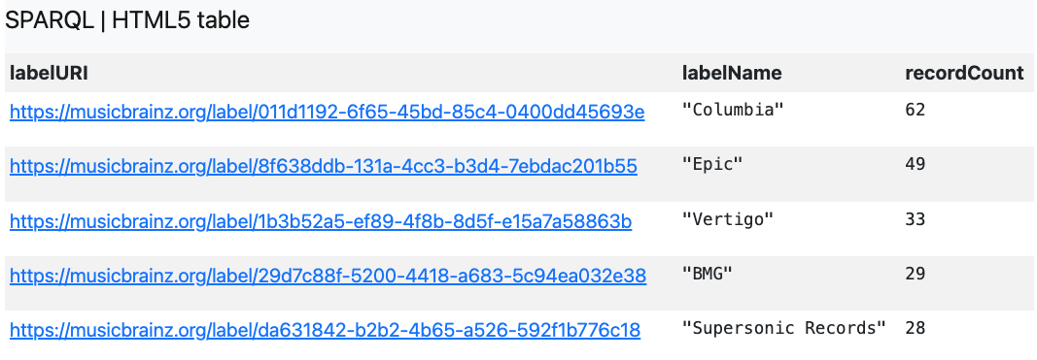
The result from Virtuoso (Q4-2)
Notes:
music chart

Slide 76
Prompting ChatGPT to generate SPARQL query (Q4-3)
Enter the following in ChatGPT (the text in red will be provided to users):
Given 2 RDF graphs, the properties, instances, classes of which are reconciled with Wikidata as much as possible, regarding SPARQL queries across different databases, refer to:
wd:Q482994 owl:equivalentClass wd:Q3972943. The values of wdt:P175 have property wdt:P31 to indicate whether the perfomer is a band.
1. For `GRAPH <http://sample/thesession/reconciled/noLangLabel>`:
wd:Q482994 a owl:Class; rdfs:label “Album”.
wdt:P175 rdfs:label “performer”; rdfs:domain wd:Q482994. wdt:P2561 rdfs:label “name”.
2. For `GRAPH <http://musicbrainz/reconciled>`:
wd:Q3972943 a owl:Class; rdfs:label “Release”.
wdt:P17 rdfs:label “country”. wdt:P585 rdfs:label “date”. wdt:P1476 rdfs:label “title”.
3. For `SERVICE <https://query.wikidata.org/sparql>`:
wd:Q215380 rdfs:label “bands”. wdt:P31
Make sure to generate a correct SPARQL for the following question[note: match value of P2561 and of P1476 in order to match the instances of wd:Q482994 and of wd:Q3972943(Please use `FILTER(?date=2003)`in SPARQL) ]:
List all albums recorded by bands in TheSession, that was released in 2003 in America
album
release
Q3972943: Release
Q482994: Album
P31:instance of
(Note: Use the properties or classes as above primarily)
Notes:
break down this

Slide 77

Generated SPARQL by ChatGPT (Q4-3) List all albums recorded by bands in TheSession, that was released in 2003 in America
PREFIX owl: <http://www.w3.org/2002/07/owl#> PREFIX rdfs: <http://www.w3.org/2000/01/rdf-schema#>
PREFIX wdt: <http://www.wikidata.org/prop/direct/> PREFIX wd: <http://www.wikidata.org/entity/>
SELECT ?albumName ?album ?performer
WHERE { GRAPH <http://sample/thesession/reconciled/noLangLabel> {
?album a wd:Q482994 ; #recording of TheSession
wdt:P2561 ?albumName ;
wdt:P175 ?performer . }
GRAPH <http://musicbrainz/reconciled> {
?release a wd:Q3972943 ;
wdt:P1476 ?releaseTitle ;
wdt:P17 wd:Q30 ; # USA
wdt:P585 ?date .
FILTER(?date = 2003)} FILTER(?albumName = ?releaseTitle)
SERVICE <https://query.wikidata.org/sparql> {
?performer wdt:P31 wd:Q215380 . }}
An additional question:
Give me NLQ that will generate this SPARQL if the query is given to you to generate the SPARQL
album
wdt:P175
performer
wdt:P2561
wdt:P31
Instance of
?albumName
Q215380 (Band)
?releaseTitle
Q30
wdt:P1476
wdt:P17
release
2003
wdt:P585
Notes:
3 different colour patches

Slide 78
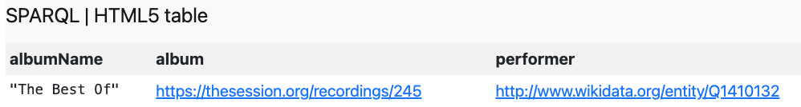
The result from Virtuoso (Q4-3)
https://thesession.org/recordings/245

Slide 79
Discussion or Issue
Am I a schema?
Should we or how to understand the ontology?
Ontology can be automatically generated during CSV2RDF in Virtuoso
Understanding OWL (Web Ontology Language) isn’t essential right now
It can be substantially seen as a graph structure, serving as a framework for the DB
A familiarity of ontology will contribute to a more professional way of asking questions. Refer to:
Q1-1 “Find the sessions that took place in Greece.” (Interoperable)
Q2-2 What genres appear in the album whose artist is "Adam Agee…"?
Q4-2 List top 5 most popular record labels used by musicians on TheSession?
Editing or visualization tools for ontology: (1) protégé (2)WebVOWL
Issue: The accuracy of SPARQL generation
What if there is a complex context (e.g., an oversized ontology)?
Not a “black box”
Notes:
Discussion:
1. Should we or how to understand the ontology? (See “ontologySnippet.ttl”)
Reference:
Understanding OWL isn’t essential right now, but having a grasp of the ontology is highly beneficial for Digital Humanities Research. “Protégé” provides a user-friendly interface for humanities scholars to manipulate ontology without the necessity to reading OWL code. Additionally, there are some RDF or Ontology visualization tool, which makes the interaction with ontology more comfortable for us.
Ontology plays a crucial role in enabling large language models (LLMs) to comprehend natural language questions. For instance, consider the query, “Find the sessions that took place in Greece.” In this case, a clear understanding of the types of entities involved is essential (refer to assertions like Q2-2(43) and Q4-2(77)). Furthermore, since every question stems from a shared understanding between the asker and the answerer, a solid grasp of ontology allows individuals to formulate questions more effectively and professionally, in accordance with the FAIR Principles.
Why do we necessarily use ontology rather than other approaches? It’s not just because ontology is well-structured. Another important reason is that ontology can be automatically generated by Virtuoso during RDB2RDF or extracted by SPARQL…
2. The bigger the context is, the higher rate of error in the generation there would be, so we will enhance the prompt engineering such as “Designing Intelligent Agents”.
Future Work:
2. Refer to Q1-3(P24), Q3-2(P60)…

Slide 80
Future Work
Further reconciliation
Knowing more about Wiki-Project Music (https://www.wikidata.org/wiki/Wikidata:WikiProject_Music)
E.g. “Find albums containing “Tola” in its name or its artist’s name” wdt:P175 performer
Prompt engineering or In-context learning:
Intelligent agents designing and RAGs
E.g., ChatGPT can even read the visualization of OWL
Knowledge-Reasoning, Recommendation, Visualization, Network Analysis…
Q4-3
Q4-2 if … a lazy searcher, asking natural language queries in a …
Notes:
Discussion:
1. Should we or how to understand the ontology? (See “ontologySnippet.ttl”)
Reference:
Understanding OWL isn’t essential right now, but having a grasp of the ontology is highly beneficial for Digital Humanities Research. “Protégé” provides a user-friendly interface for humanities scholars to manipulate ontology without the necessity to reading OWL code. Additionally, there are some RDF or Ontology visualization tool, which makes the interaction with ontology more comfortable for us.
Ontology plays a crucial role in enabling large language models (LLMs) to comprehend natural language questions. For instance, consider the query, “Find the sessions that took place in Greece.” In this case, a clear understanding of the types of entities involved is essential (refer to assertions like Q2-2(43) and Q4-2(77)). Furthermore, since every question stems from a shared understanding or common cognitive framework between the asker and the answerer, a solid grasp of ontology allows individuals to formulate questions more effectively and professionally, in accordance with the FAIR Principles.
Why do we necessarily use ontology rather than other approaches? It’s not just because ontology is well-structured. Another important reason is that ontology can be automatically generated by Virtuoso during RDB2RDF or extracted by SPARQL…
2. The bigger the context is, the higher rate of error in the generation there would be, so we will enhance the prompt engineering such as “Designing Intelligent Agents”.
Future Work:
2. Refer to Q1-3(P24), Q3-2(P60)…
warn ChatGPT of...

Slide 81
Thank you!
Junjun Cao
Postdoctor of DDMAL
Email: junjun.cao@mail.mcgill.ca
Notes:
Tips:
(1) SPARQL and Ontology are essentially a graph structure. They are not dreadful.
(2) Reminder: mandarin market

